Slide 1
Modeling a Fast Spiking Interneuron
Project 1a
Tyler Banks

Slide 2
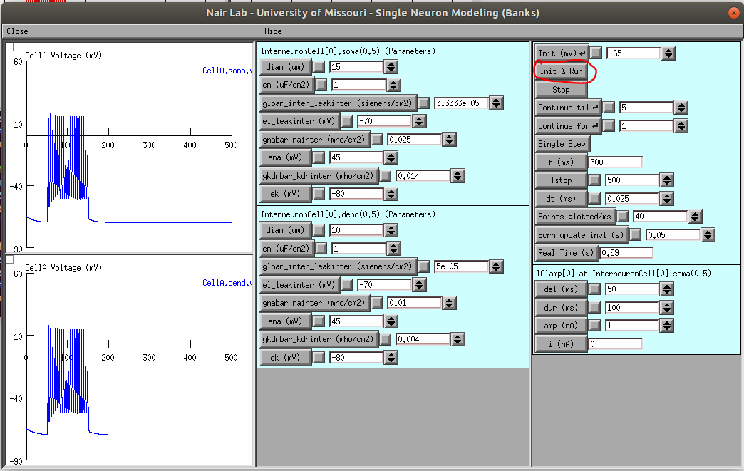
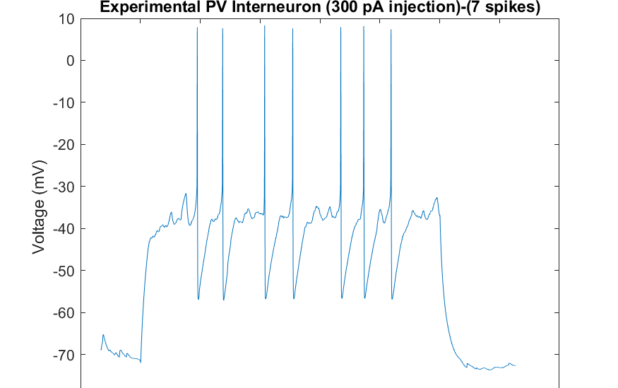
Problem Statement
Design a model Parvalbumin-expressing (PV) interneuron with specified passive and firing properties from experimental data.
Match experimental passive and firing properties.

Slide 3
Passive Cell Properties
Time constant
Resting membrane potential
Input resistance
What are each of these?
What about the cell can be changed to alter these values (Capacitance, channel density, etc)?
Notes:
T

Slide 4
Firing Properties
Responses to various current injection values by varying only kdr
The frequency-current response (FIR) curve for the neuron.

Slide 5
Running the Code
Download the Interneuron zip file from Canvas
Drag and drop the file on to your NeuroVM desktop
Execute the following commands from the terminal
> cd Desktop > unzip Project1a-Interneuron-5.zip > cd Project1a-Interneuron-5 > nrnivmodl > nrngui main.hoc

Slide 6
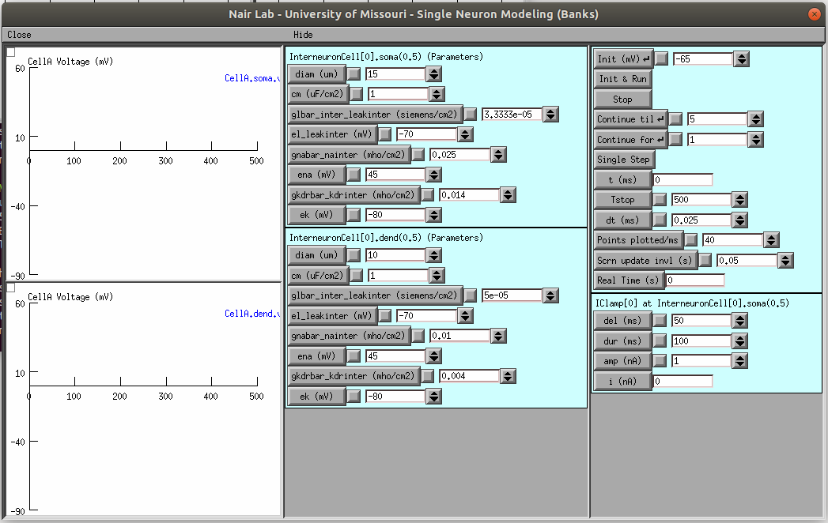
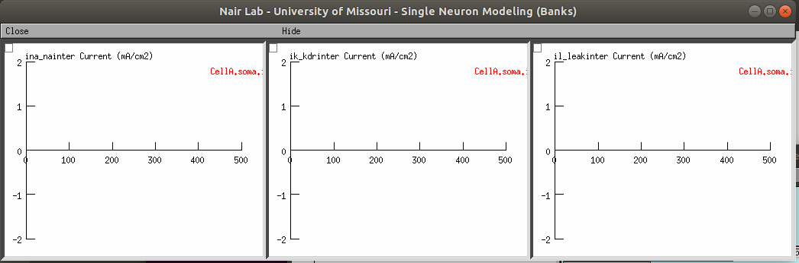
> cd Desktop > unzip Project1a-Interneuron-5.zip > cd Project1a-Interneuron-5 > nrnivmodl > nrngui main.hoc
This is the main interface you’ll use to tune the model. You can change parameters like capacitance, leak conductance, etc. all from the GUI, no coding should be necessary.

Slide 7
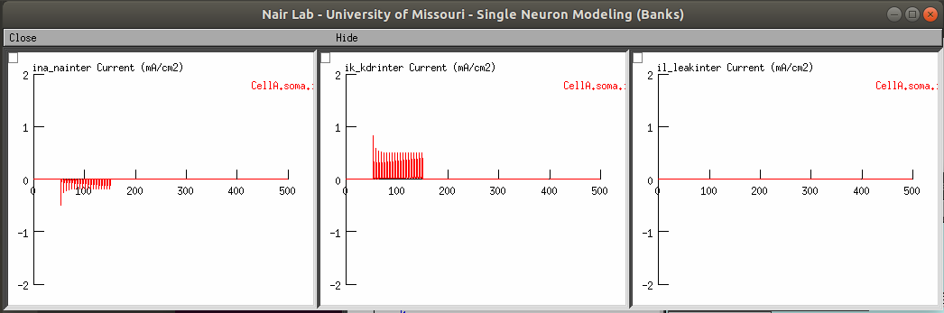
> cd Desktop > unzip Project1a-Interneuron-5.zip > cd Project1a-Interneuron-5 > nrnivmodl > nrngui main.hoc

Slide 8
